Slide 1
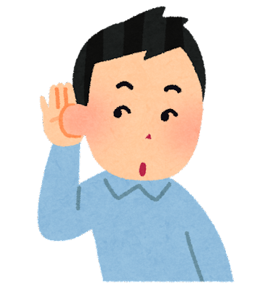
Listen Carefully

Slide 2
his or has

Slide 3
live or love

Slide 4
mind or mine

Slide 5
poor or power

Slide 6
of or off

Slide 7
fan or fun

Slide 8
sing or sang

Slide 9
man or men

