Slide 1
Saturday
Sunday
Friday
SPIN
Monday
Thursday
Tuesday
Wednesday
Notes:
7 Segments

Slide 2
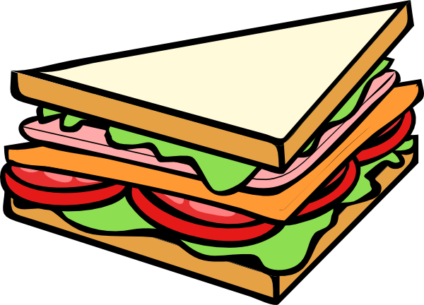
Saturday
Sunday
Friday
SPIN
Monday
Thursday
Tuesday
Wednesday
Notes:
7 Segments

