Slide 1
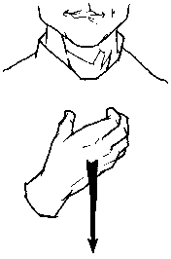
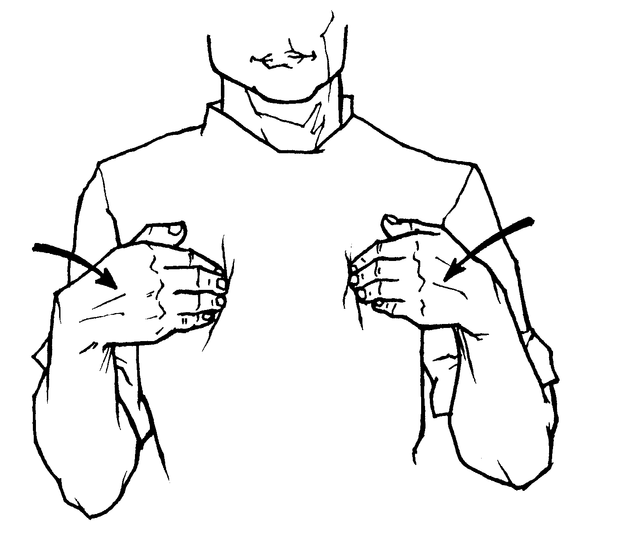
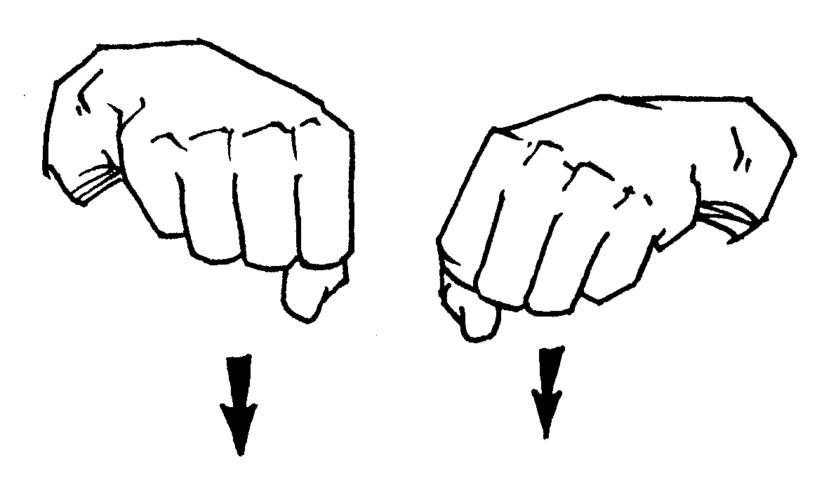
American Sign Language
wish | had | were | could

Slide 2
I wish I could…
I wish I were…
I wish I had…

