Slide 1
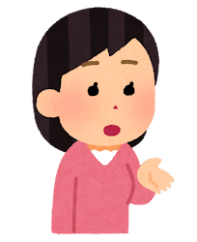
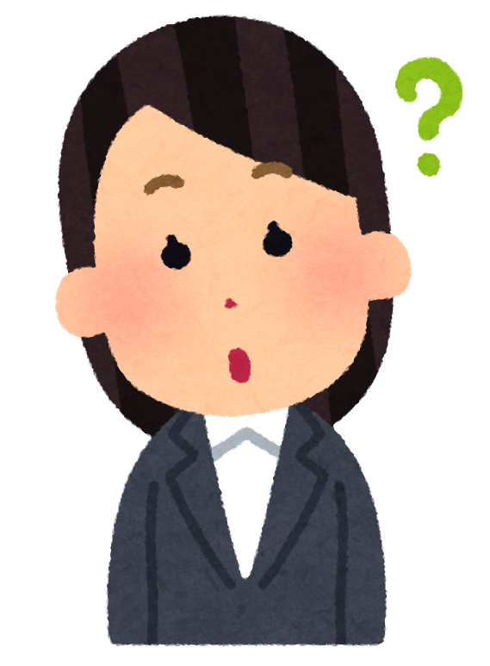
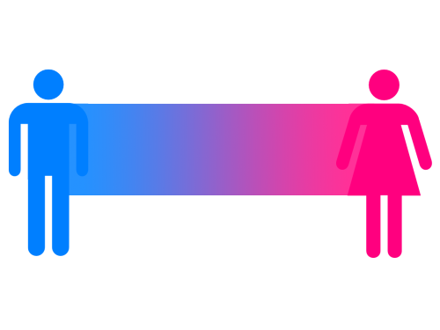
LGBTQ & Pronouns
https://www.genderspectrum.org/
英語で！
代名詞
What pronoun do you use?
What's
"non-binary"?
Non-binary (ノンバイナリー) is a gender, like men and women.
I use "they"!
Non-binary means "gender neutral," or 性別なし, 中性.
Or "he" or "she"
Similar to "X-gender."
ジェンダースペクトラム
How do I use "they"?
例 They are my friend.
They like baseball.
Their shirt is purple.
I want to play with them.
man
non-binary
woman
アイデンティティ
知らない人の例: I have a new neighbor! I hope they like Pokemon.
?
代名詞
he
they
she

