Slide 1
Go Fish
Pronunciation Help

Slide 2
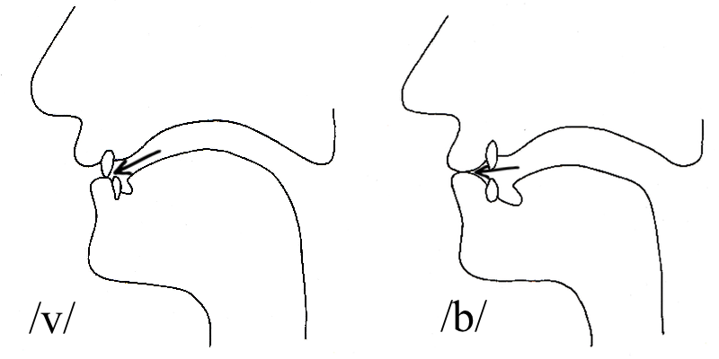
/b/ and /v/
Ban Van
Berry Very
Boat Vote
Curb Curve
Lips together
Top teeth on lips

Slide 3
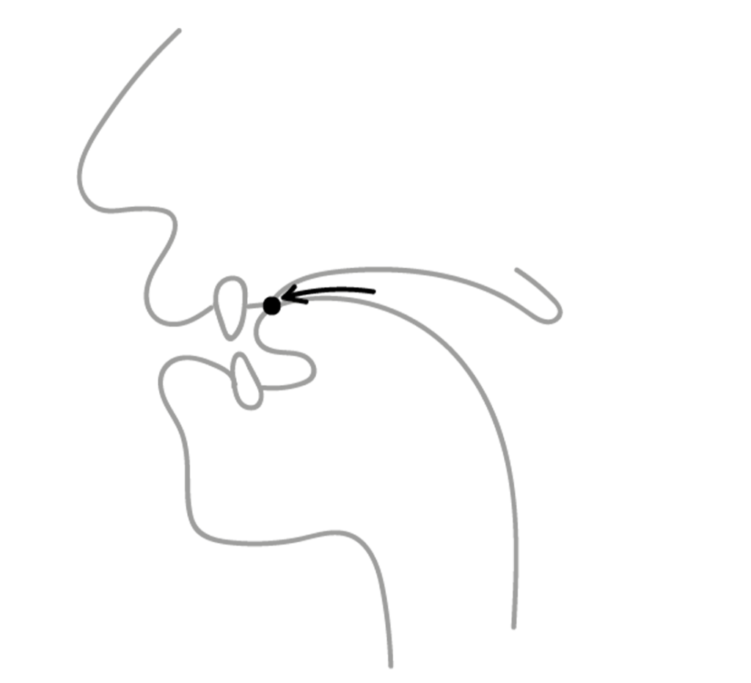
/s/ and /θ/
Sing Thing
Mouse Mouth
Sink Think
Mass Math
Tongue on top teeth
Tongue behind teeth

Slide 4
More Practice
Bat Vat
Bow Vow
Base Vase
Dub Dove
Sank Thank
Worse Worth
Sick Thick
Pass Path

Slide 5
/æ/ and /ʌ/
Mouth open and like a smile. Tongue flat
(A and U)
Mouth slightly closed. Tongue slightly raised
Cat Cut
Cap Cup
Fan Fun
Hat Hut

Slide 6
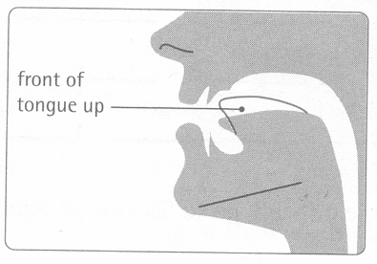
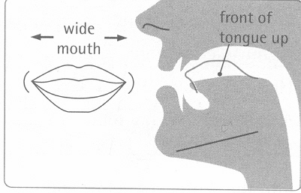
/ɪ/ and /i:/
His He’s
It Eat
Hill Heel
Chip Cheap
More of a smile

Slide 7
More Practice
Bat But
Mad Mud
Rang Rung
Sang Sung
Bin Bean
Bit Beat
Chick Cheek
Hill Heel

Slide 8
One More Time
Ban Van
Berry Very
Boat Vote
Curb Curve
Sing Thing
Mouse Mouth
Sink Think
Mass Math
Cat Cut
Cap Cup
Fan Fun
Hat Hut
His He’s
It Eat
Fill Feel
Chip Cheap

