Slide 1
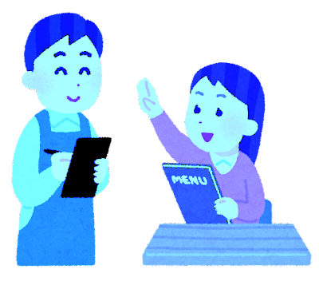
Let's Talk (2)- ていねいなお願い
You are at a restaurant.
Please order 1 food item.
If you don't like it, ask for a different food item
(A)Customer: Excuse me. May I ask you a favor?
(B)Waiter/Waitress: Sure!
Customer: Could you show me a menu?
Waiter/Waitress: All right. Here you go.
Customer: Could I have the _________?
Waiter/Waitress: All right. Here you go!
.......................................................................................
Customer: I'm sorry, but could I have the _________ instead, please?
Waiter/Waitress: OK. No problem. Here you go.
Customer: Thank you........

