Slide 1
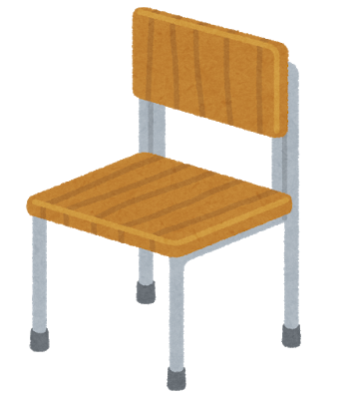
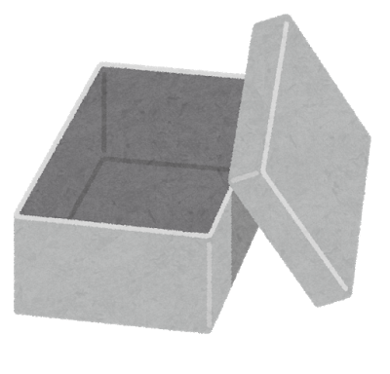
Name: ____________________ Class: ___-___ Number: _____ Date: ________________ Program 5-2, “Where”
Where [is/are] the … ?
Question
Answer
Where is the basketball? It’s on the chair.
the camera? It’s on the floor.
the book? It’s in the box.
It’s under the chair.
Where are the cups? They’re on the chair.
They’re on the floor.
They’re in the box.
They’re under the chair.
Is it room [1]? Yes, it is.
No, it isn’t.
1
2
3
4
5
6
7
8
9
10
11
12
13
14
15
16

