Slide 1
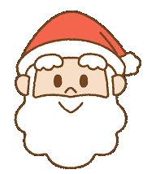
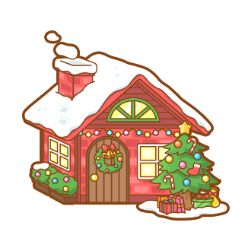
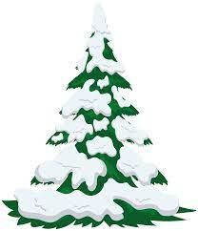
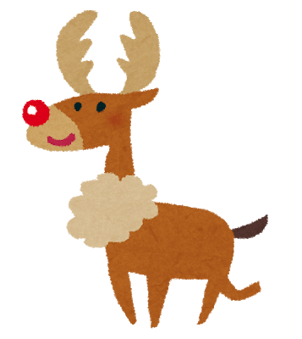
CARD
CARD
GET
GO
CARD
GO
Forward
Forward
3
2
GO
GO
LOSE
Back
Back
CARD
GET
GO
CARD
2
2
Back
CARD
2
LOSE
LOSE
GET
LOSE
CARD
CARD
1st – 3 pts
2nd – 2 pts
3rd – 1 pt
Finish
GET
CARD
CARD
GET
GO
CARD
GO
Back
GO
Forward
GO BACK
TO START
1
Back
3
3
GET
GO
CARD
Back
GO
3
Back
2
CARD
GET
GO
CARD
Forward
CARD
1
LOSE
GO
GET
START
Forward
GO
CARD
GET
GO
1
Forward
Back
1
1

Slide 3
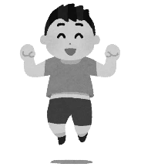
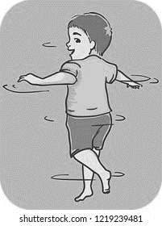
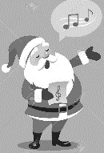
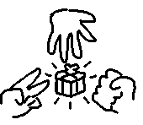
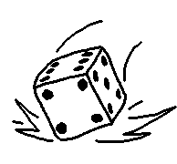
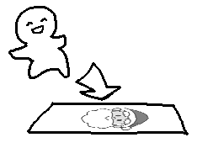
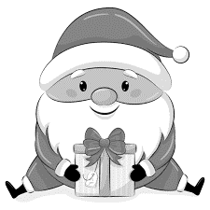
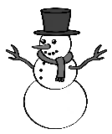
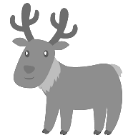
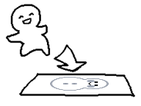
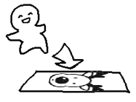
Switch! | Switch! | What color do you like? 英語で答えてください： “何色がすきですか？” ” | What food do you like? 英語で答えてください： “好きな食べ物は何ですか？ | What animal do you like? 英語で答えてください： ”好きなどうぶつは何ですか？” | What day is it today? 英語で答えてください： “何曜日ですか？” | When is your birthday? 英語で答えてください： ”お誕生日はいつですか？“
Ask the teacher “What _____ do you like?” ホワットゥ ◯ ◯ ドゥ ユー ライク | Ask the teacher “Can you ______?” キャン ユー ◯ ◯ | Do 5 squats! x5 | Ask the teacher “How are you?” ハウ アー ユー | Jump 3 times! x3 | Sing a Christmas song! Get | Turn around 3 times! x3
Janken with teacher! Win = | Janken with teacher! Win = | EVERYONE Janken! Win = | One more turn! | One more turn! | One more turn! | Move to the next space!
Move to the next space! | Move to the next space! | Get a present! | Get a present! | Draw Santa on the blackboard! こくばんにサンタさんの絵を描きなさい。 | Draw a snowman on the blackboard! こくばんにゆきだろまの絵を描きなさい。 | Draw a reindeer on the blackboard! こくばんにトナカイの絵を描きなさい。

Slide 4
Chance | Chance | Chance | Chance | Chance | Chance | Chance
Chance | Chance | Chance | Chance | Chance | Chance | Chance
Chance | Chance | Chance | Chance | Chance | Chance | Chance
Chance | Chance | Chance | Chance | Chance | Chance | Chance

