Slide 1
Jeopardy
Unit5

Slide 2
Jeopardy -Unit5-
English ↓ Japanese | Japanese ↓ English | Scramble words | Questions | Contents
100 | 100 | 100 | 100 | 100
200 | 200 | 200 | 200 | 200
300 | 300 | 300 | 300 | 300
400 | 400 | 400 | 400 | 400
500 | 500 | 500 | 500 | 500

Slide 3
Jeopardy English-Japanese100
glad
うれしい

Slide 4
Jeopardy English-Japanese200
disabled
身体の不自由な

Slide 5
Jeopardy English Japanese300
society
社会

Slide 6
Jeopardy English-Japanese400
barrier
壁, 障壁 , バリア

Slide 7
Jeopardy English-Japanese500
braille
点字

Slide 8
Jeopardy Japanese-English100
役に立う
helpful

Slide 9
Jeopardy Japanese-English200
つかむ
hold

Slide 10
Jeopardy Japanese-English300
子供のころ 英語
childhood

Slide 11
Jeopardy Japanese-English400
こちらに , こちらでは
over here

Slide 12
Jeopardy Japanese-English500
直に 、直接に
first-hand

Slide 13
Jeopardy scramble words100
v - e - n - e
even

Slide 14
Jeopardy scramble words200
a - e - i -d
idea

Slide 15
Jeopardy scramble words300
r - a - p - m
ramp

Slide 16
Jeopardy scramble words400
u-i-v-r-s-a-n-e-l
universal

Slide 17
Jeopardy scramble words500
h-h-e-e-a-c-
i-l-r-w
wheelchair

Slide 18
Jeopardy Questions100
If it’s sunny tomorrow,
What will you do?
I will ~~~.

Slide 19
Jeopardy Questions200
What sports do you like?
Why?
I like ~ because ….

Slide 20
Jeopardy Questions300
What did you eat for
lunch yesterday?
I ate ~~~.

Slide 21
Jeopardy Questions400
How do you come to school?
By bus/train. I walk to school.

Slide 22
Jeopardy Questions500
How long does it take for you to come to school?
It takes about ~ minutes/hour.

Slide 23
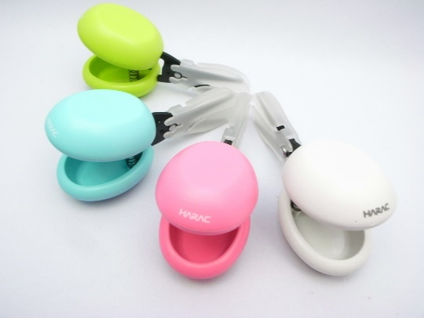
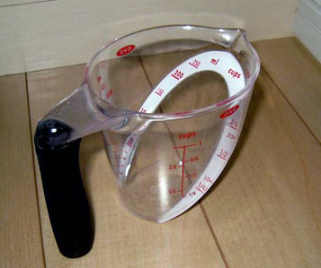
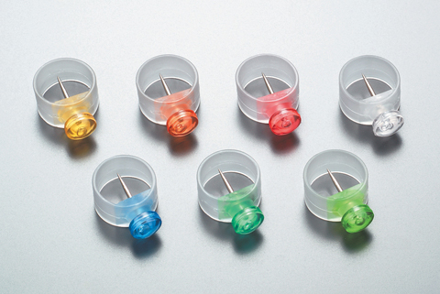
Jeopardy Contents100
What are they?
Universal design products.

Slide 24
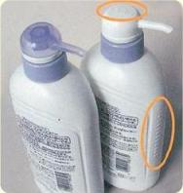
Jeopardy Contents200
What does
shampoo bottle have?
It has bumps.

Slide 25
Jeopardy Contents300
Could Saki use
the wheelchair easily?
No, she couldn’t.

Slide 26
Jeopardy Contents400
What can you use
if you’re in a wheelchair?
You can use the ramp.

Slide 27
Jeopardy Contents500
Who is the father of universal design?
Ronald Mace

