Slide 1
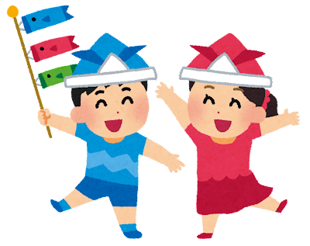
Class____ No. ____ Name_______
A. What did you do on these days?
On Constitution Day (憲法記念日,) I ____________________.
Children’s Day (こどもの日) I _________________________.
On Greenery Day (みどりの日) I _______________________.
B. Ask a classmate about when they were ten and write their answers.
When you were ten, what did you watch on TV?
_____________________________________________.
When you were ten, what did you like?
_____________________________________________.
When you were ten, what did you eat?
_____________________________________________.
C. Look at the times. What were you doing then?
On Saturday morning, I was ___________________ .
On Saturday afternoon, I was ___________________.
On Sunday night, I was ___________________.
D. Think about when you were ten-years-old and try to answer the questions.
When I was ten, I watched ___________________ on TV.
When I was ten, I played ___________________.
When I was ten, I read ___________________.
When I was ten, I ate ___________________.
_______________, I wanted to be a ___________________.
_______________, I liked ___________________.

