Slide 1
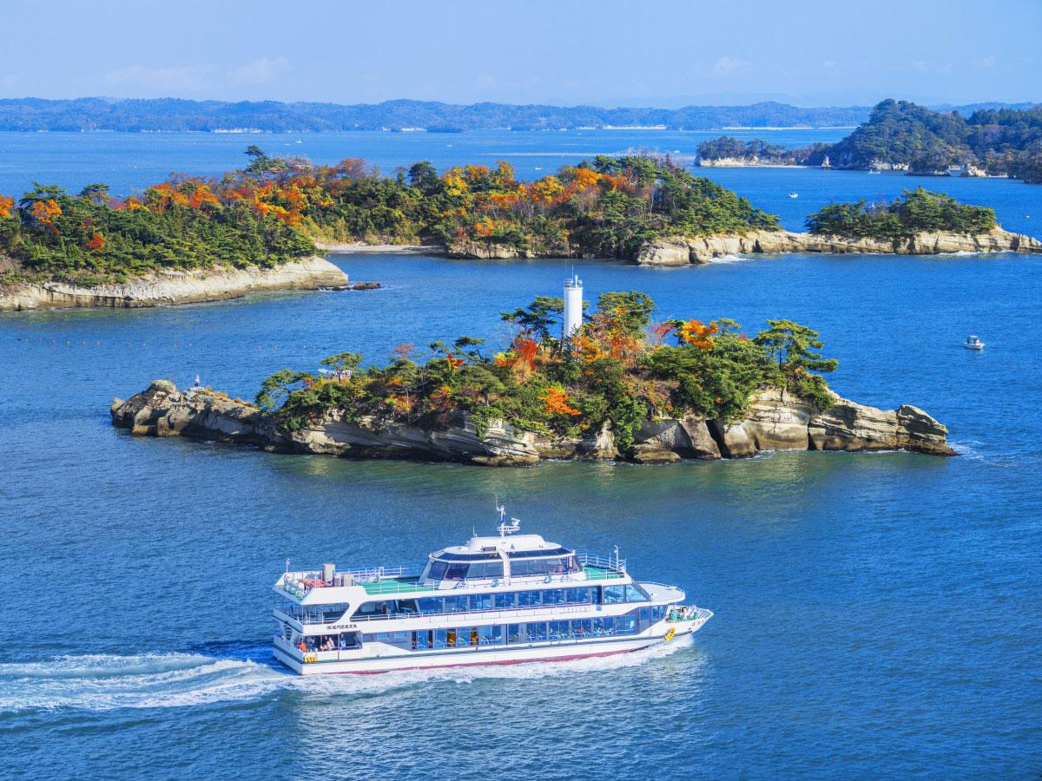
Sightseeing boat in Matsushima Bay.
松島湾の遊覧船。

Slide 2
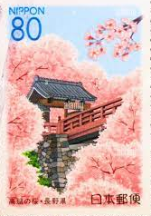
November 18, 2023
Dear Mom,
I went to Matsushima Bay last weekend. It was very beautiful. I went on a sightseeing boat and saw many islands. Then, I went to Zuiganji Temple. It was very crowded. I bought an omamori. It is very cute. I miss you. Take care of yourself. I love you.
Much love,
Trysten

Slide 3
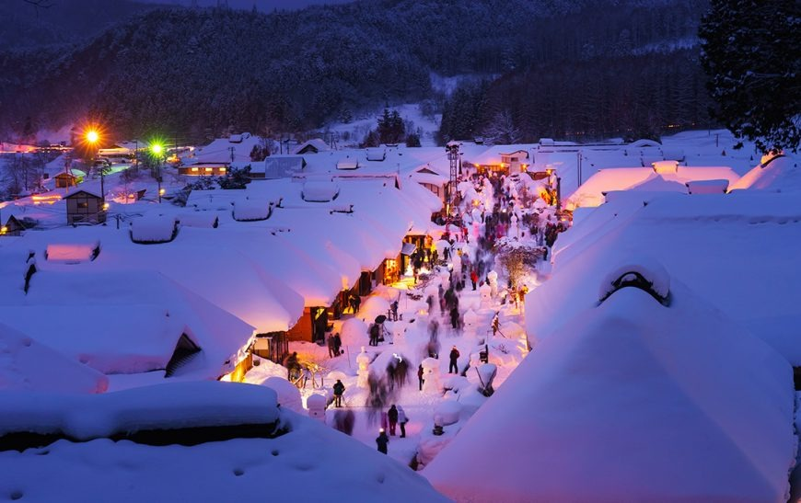
Ouchijuku Snow Festival.
大内宿雪まつり。

Slide 4
February 11, 2023
Dear Abby,
It is very cold in Aizutakada. We have a lot of snow. This weekend, I went to the Ouchijuku Snow Festival. It was very fun and beautiful. I ate negi soba and drank barley tea. I saw beautiful fireworks too. I miss you and Marco!
I love you! See you soon.
Best,
Trysten

Slide 5
ここに写真を貼ってください！
画像のキャプションはここに - 具体的に！

Slide 6
日付 - 月, 日, 年
(In English!!)
Dear だれが,
ハガキの本文はここに書く-地名と何をしたかを書く。少なくとも4つの文章を書く。
過去形を使うことを忘れずに！
終わり挨拶,
あなたの名前
ここにスタンプを押す。

Slide 7
使える過去形の動詞
ate | saw | went
enjoyed | bought | stayed
cleaned | cooked | played
"was "は "is "の過去形であることを覚えておいてほしい。
例: “It is fun.” → “It was fun.”

Slide 8
使える終わりの挨拶
Best, | Much love, | Sincerely,
Best regards, | Take care, | Yours truly,
最後の挨拶の後のコンマをお忘れなく。

Slide 9
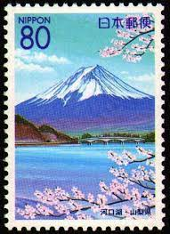
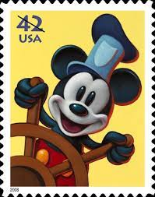
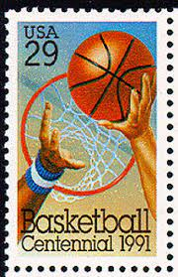
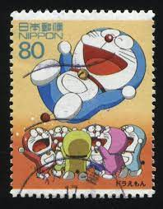
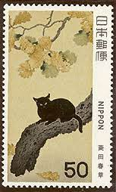
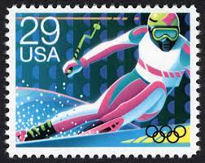
Stamps! PLEASE USE ONE!

