Slide 1
Grammar Review!

Slide 2
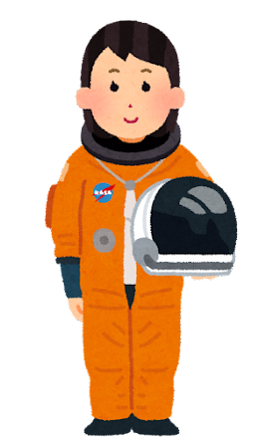
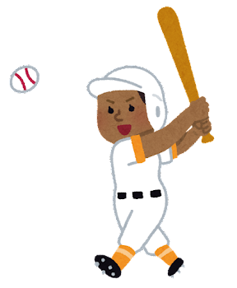
Vocabulary
宇宙飛行士 | 野球選手 | 医師 | 消防士 | 画家 | 科学者 | 教師
astronaut
baseball player
doctor
fireman
artist
scientist
teacher

Slide 3
HOW TO PLAY

Slide 4
ピカチュウ is (cute) than ゴローン.
cuter
1
-2
5
4
2
0
-1

Slide 5
READY?

Slide 6
Q: Are you going to Australia next year?
A: ( )
1). Yes, I be. 2). No, I aren’t. 3). No, it’s not. 4). Yes, I am.
2
5
-2
1
0
3
-1

Slide 7
A: Let’s go to a concert!
B: Great! I ( ) the tickets.
1). won’t buy 2). will buy 3). don’t buy
4). do buy
1
3
-2
5
2
-1
1

Slide 8
I will ( ) you the way.
1). give 2). try 3). help 4). show
-1
2
-1
2
-1
2
2

Slide 9
Q: What is your name?
A: People (c ) me Ada.
call
1
2
3
0
3
2
1

Slide 10
I know you’re busy, but (i ) you have time, we can go.
if
4
2
1
-2
5
-1
0

Slide 11
Q: Do you like umeboshi?
A: No, I do not like umeboshi, (b ) I do not like sour food.
because
2
5
-2
1
0
3
-1

Slide 12
We use smart phones (do) many things.
to do
0
4
3
2
1
-2
5

Slide 13
To get a 100 on the test you (h ) to study.
have
2
3
5
0
1
-1
-1

Slide 14
In Japan, you ( ) take off your shows before coming inside.
1). must 2). musn’t 3). can’t 4). won’t
3
3
3
3
3
3
3

Slide 15
When I visited my grandparents, ( ) was fun.
1). play games 2). played games 3). playing games 4). doing games
-1
-1
1
1
5
3
2

Slide 16
This movie is the (old) of the three.
oldest
0
2
1
-2
3
5
4

Slide 17
This game is the ( ) interesting this year.
1). best 2). most 3). better 4). worst
-2
5
3
0
-1
4
2

Slide 18
I like animated movies the ( ) of all.
1). better 2). less 3). badder 4). worst
-3
3
-3
3
-3
3
-3

Slide 19
This Pokémon is (a ) cute (a ) that Pokémon.
as, as
0
5
1
-2
4
3
-1

Slide 20
The song is ( ) by the students.
1). heard 2). hear
3). listened 4). hearing
3
-1
0
1
2
5
-1

Slide 21
Are the exams finished?
1). No, they can’t. 2). No, it’s not. 3). No, they aren’t. 4). No, it can’t.
7
-3
2
-2
0
8
1

