Slide 1
Let’s review our INFINITIVES!
Arrange the words to make it a sentence.

Slide 2
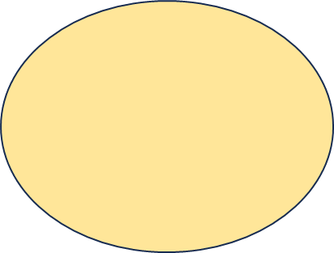
computers
use
do
to
things
We
many

Slide 3
We use computers to do many things.
computers
use
do
to
things
We
many

Slide 4
to
up
I
early
new
got
movie
the
see

Slide 5
I got up early to see the new movie.
to
up
I
early
new
got
movie
the
see

Slide 6
went
to
I
a
bookstore
for
to
books
look
interesting

Slide 7
I went to a bookstore to look for interesting books.
to
a
went
I
bookstore
look
interesting
to
for
books

Slide 8
about
job
I’m
surprised
hear
to
their

Slide 9
I’m surprised to hear about their job.
job
about
to
I’m
their
hear
surprised

Slide 10
some
eggs
we
make
to
bought
cakes

Slide 11
We bought some eggs to make some cakes.
some
eggs
we
make
to
bought
cakes

Slide 12
a
lot
work
do
we
of
have
to

Slide 13
We have a lot of work to do.
work
do
a
lot
have
we
to
of

Slide 14
I’m
see
to
this
surprised

Slide 15
I’m surprised to see this.
see
I’m
to
surprised
this

Slide 16
to
you
I’m
meet
happy

Slide 17
I’m happy to meet you.
to
you
I’m
meet
happy

Slide 18
to
we
things
many
have
learn

Slide 19
We have many things to learn.
to
things
we
many
have
learn

Slide 20
is
English
to
it
necessary
study

Slide 21
It is necessary to study English.
is
English
to
it
necessary
study

Slide 22
is
to
use
effectively
it
important
AI

Slide 23
It is important to use AI effectively
is
to
use
effectively
it
important
AI

Slide 24
is
to
difficult
it
do
translations

Slide 25
It is difficult to do translations.
is
to
difficult
it
do
translations

Slide 26
world
English
around
the
people
I
talk
to
with
study

Slide 27
I study English to talk with people around the world.
world
English
around
the
people
I
talk
to
with
study

