Slide 1
Entrance Exam Review!

Slide 2
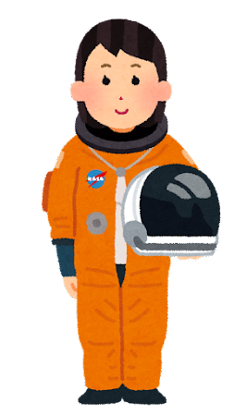
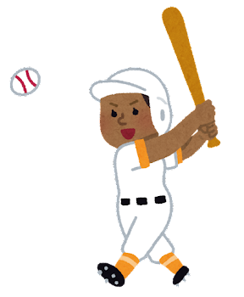
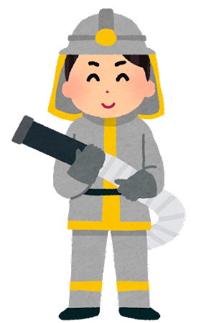
Vocabulary
宇宙飛行士 | 野球選手 | 医師 | 消防士 | 画家 | 科学者 | 教師
astronaut
baseball player
doctor
fireman
artist
scientist
teacher

Slide 3
HOW TO PLAY

Slide 4
A: Look at the stars in the sky!
B: Wow! ( ) are beautiful.
1). You 2). Its 3). They 4). There
1
-2
5
4
2
0
-1

Slide 5
I usually ( at / up / get ) six thirty.
get up at
3
4
-2
1
-1
0
2

Slide 6
Nancy: How ( ) is this T-shirt, Yuki?
Yuki: It’s 800 yen.
1). many 2). long 3). much 4). often
0
-3
-1
2
4
1
5

Slide 7
READY?

Slide 8
I had to get up early the next day, so I (go) to bed early that night.
went
0
2
3
4
-2
1
2

Slide 9
Kaori: You and Jim are friends, right?
Bill: Yes. We know (e ) other well.
each
-2
0
5
1
2
3
-1

Slide 10
Nancy: Who ( ) you English last year?
Takuya: Mr. Suzuki did.
1). teach 2). teaches 3). teaching 4). taught
2
5
-2
1
0
3
-1

Slide 11
Tom: How is the (w ) today?
Maki: It’s sunny now but it will rain in the afternoon.
weather
1
3
-2
5
2
-1
1

Slide 12
Yoshio has two brothers and he is the ( ) of the three.
1). younger than 2). youngest 3). young 4). as young
-1
2
-1
2
-1
2
2

Slide 13
Now I am studying English (hard) than before.
harder
1
2
3
0
3
2
1

Slide 14
A: May I help you?
B: Yes. I want a hat.
A: OK. ( )
1). How about this one?
2). You’ll help me a lot. 3). How much is this cap? 4). You can come another day.
4
2
1
-3
5
-3
0

Slide 15
These ( ) my textbooks.
1). am 2). is 3). are 4). be
2
5
-2
1
0
3
-1

Slide 16
Haruko: How (a ) going to the town library?
Mr. Smith: Really? That’s a good idea.
about
0
4
3
2
1
-2
5

Slide 17
I can’t play the piano, but I’m interested in ( ) to music.
1). hearing 2). hear 3). listening 4). listen
2
3
5
0
1
-1
-1

Slide 18
Mother: What do you want to eat for (d ) tonight?
Kelly: I want to eat curry.
dinner
3
3
3
3
3
3
3

Slide 19
That house with large windows ( ) built ten years ago.
1). lives 2). is 3). was 4). were
-1
-1
1
1
5
3
2

Slide 20
I saw drawings in the train. Do you know ( ) drew them?
1). that 2). what 3). whose 4). who
0
2
1
-2
3
5
4

Slide 21
I don’t know ( ) to get to the museum. I have to ask someone.
1). which 2). where 3). how 4). what
-2
5
3
0
-1
4
2

Slide 22
A: I like summer. How about you?
B: I like spring the ( ) of all seasons.
1). much 2). more 3). better 4). best
-3
3
-3
3
-3
3
-3

Slide 23
We work (f ) Sunday ( ) Monday.
from, to
0
5
1
-2
4
3
-1

Slide 24
A: “( ) speak in the library, please.”
B: “Oh, sorry.”
1). Do 2). Don’t 3). No 4). Not
3
-1
0
1
2
5
-1

Slide 25
It’s a picture ( ) by Ken.
1). takes 2). taken 3). took 4). taking
4
2
-2
3
0
1
5

Slide 26
If it (w ) sunny today, I ( ) go shopping.
were, would
7
-3
2
-2
0
8
1

