Slide 1
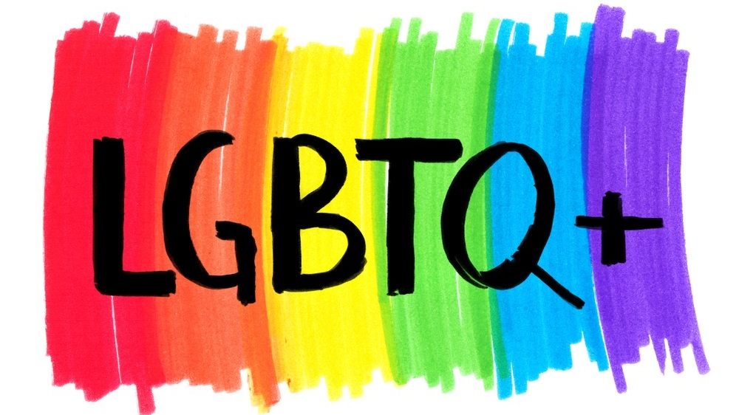

Slide 2
L stands for Lesbian
G stands for Gay
Lesbian means a woman who is attracted to other women
Gay means a person is attracted to those of the same gender. Gay is also an umbrella term for all members of the community

Slide 3
B stands for Bisexual
T stands for Transgender
Bisexual means a person who is attracted to two or more genders
Transgender means a person’s gender identity does not match their assigned gender at birth

Slide 4
Q stands for Queer
Represents all identities in the LGBT community. It can also mean, “Questioning”

Slide 5
Lesbian Pride Flag

Slide 6
Gay Pride Flag

Slide 7
Transgender Pride Flag

Slide 8
Bisexual Pride Flag

Slide 9
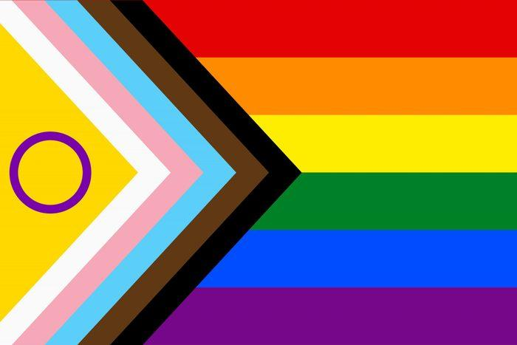
LGBTQ+ Progress Flag

