Slide 1
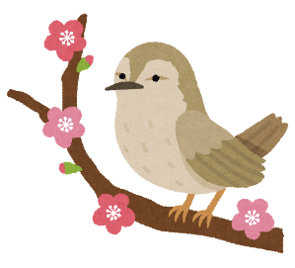
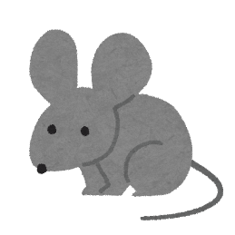
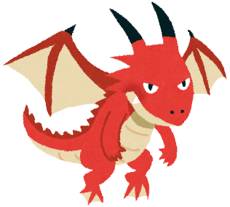
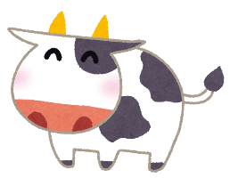
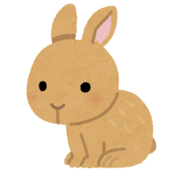
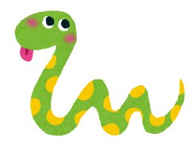
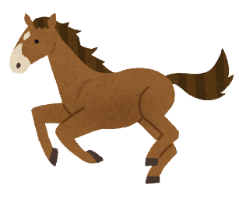
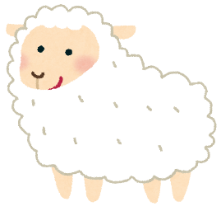
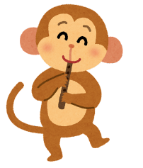
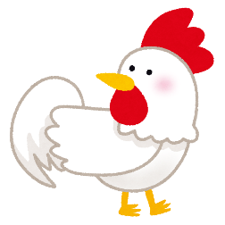
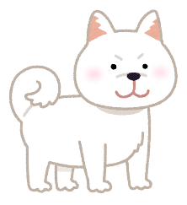
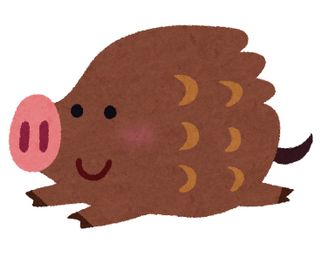
ANIMAL WORD SEARCH
D R A G O N J A S Y P C O A N H O R S E N H R O
G B M O U S E N A E E W
O B R E I M O N K E Y E
T I G E R M S H E E P T L T E Y B C H I C K E N
E W I L D B O A R M T P
MOUSE COW TIGER RABBIT DRAGON SNAKE
HORSE SHEEP MONKEY CHICKEN DOG WILD BOAR

Slide 2
WORD SEARCH
D R A G O N J A S Y P C O A N H O R S E N H R O
G B M O U S E N A E E W
O B R E I M O N K E Y E
T I G E R M S H E E P T L T E Y B C H I C K E N
E W I L D B O A R M T P
MOUSE COW TIGER RABBIT DRAGON SNAKE
HORSE SHEEP MONKEY CHICKEN DOG WILD BOAR

Slide 3
WORD SEARCH
D R A G O N J A S Y P C O A N H O R S E N H R O
G B M O U S E N A E E W
O B R E I M O N K E Y E
T I G E R M S H E E P T L T E Y B C H I C K E N
E W I L D B O A R M T P
MOUSE COW TIGER RABBIT DRAGON SNAKE
HORSE SHEEP MONKEY CHICKEN DOG WILD BOAR

