Slide 1
One Piece Treasure Hunt

Slide 2
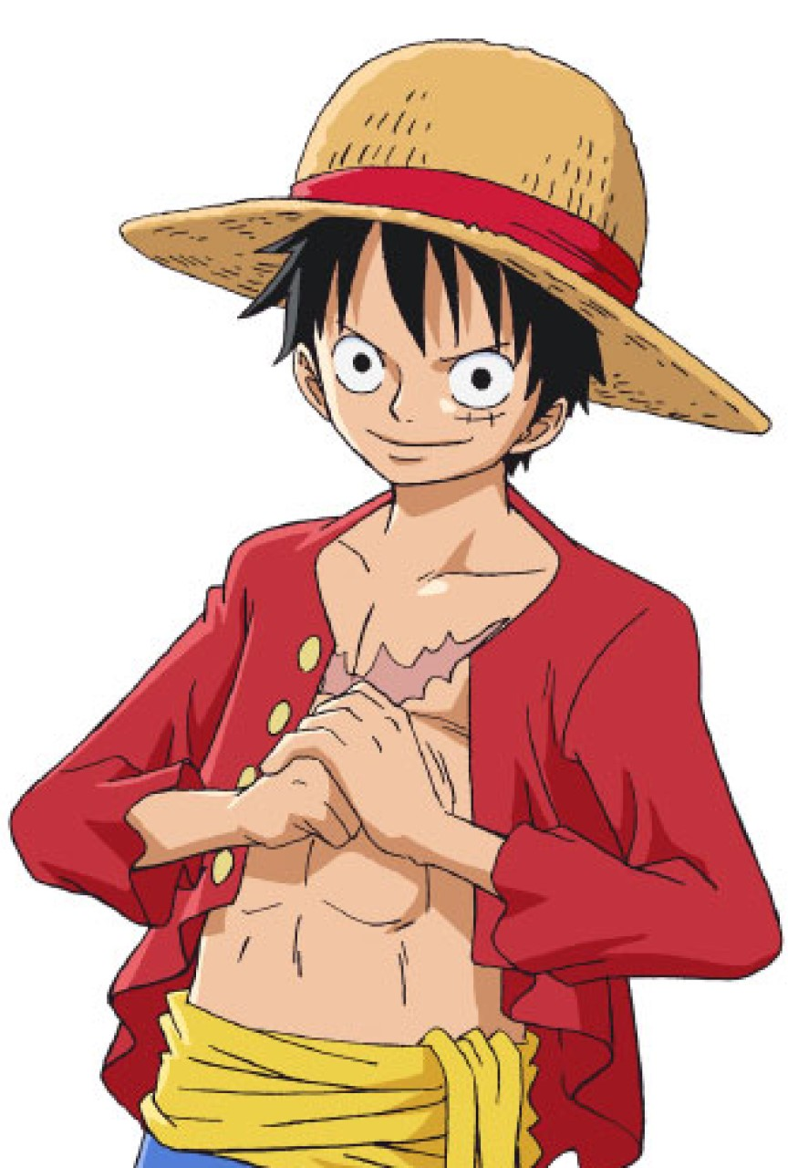
You are Monkey D. Luffy and your goal is to:
Go to Laugh Tale island.
Find the One Piece treasure.
Become the pirate (海賊) king!
To find the treasure you must use your brain and solve puzzles.

Slide 3
Rules
Make teams of 4 or 5 people.
Each team will get a puzzle.
When you solve the puzzle, bring it to me. If it is correct, you will get the next puzzle.
The first team to solve all the puzzles wins!

