Slide 1
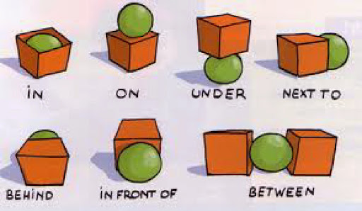
PREPOSITIONS
by

Slide 2
on

Slide 3
in

Slide 4
under

Slide 5
by

Slide 6
behind

