Slide 1
FOREST
JEOPARDY
QUIZ

Slide 2
THE TOPICS

Slide 3
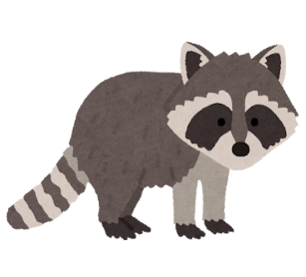
WHICH ONE?
CHANGE TO ENGLISH
CHANGE TO JAPANESE
GRAMMAR MISTAKE
10
10
10
10
20
20
20
20
30
30
30
30
40
40
40
40

Slide 4
My mother (letting/let/gave) me eat the cookie.
My mother let me eat the cookie.
WHICH ONE?

Slide 5
My brathor helping me with my homework.
My brother helped me with my homework.
GRAMMAR MISTAKE

Slide 6
WHICH ONE?
CHANGE TO ENGLISH
CHANGE TO JAPANESE
GRAMMAR MISTAKE
10
10
10
10
20
20
20
20
30
30
30
30
40
40
40
40

Slide 7
Let me (opens/open/opened) the window for you.
Let me (open) the window for you.
10

Slide 8
She (helped / help / helping) me carry the books yesterday.
She (helped) me carry the books yesterday.
20

Slide 9
My father let (I / me / they) play games last night.
My father let (me) play games last night.
30

Slide 10
I helped (his / him) (caught / catch) the fish.
I helped (him) (catch) the fish.
40

Slide 11
私は彼が掃除するのを手伝いました。
I helped him clean.
10

Slide 12
先生は私に勉強するのを手伝ってくれました。
The teacher helped me study.
20

Slide 13
彼女は私をお祭りに行かせてくれました。
She let me go to the festival.
30

Slide 14
ケンタは私に彼のペンを使わせてくれました。
Kenta let me use his pen.
40

Slide 15
Let me close the door.
私にドアを閉めさせてください。
10

Slide 16
Aya helped her study.
アヤが彼女の勉強を手伝いました。
20

Slide 17
My parents let me go to Rycom mall.
両親は私をRycomに行かせてくれました。（許してくれました）.
30

Slide 18
Mother let me make dinner.
母は私に夕食を作らせてくれました。（ゆるしてくれました）
40

Slide 19
Let me talked about my winter vacation.
Let me talk about my winter vacation.
10

Slide 20
I lets the cat in the hause.
I let the cat in the house.
20

Slide 21
Ms. kodi help me do my english homework yesterday.
Ms. Kodi helped me do my English homework yesterday.
30

Slide 22
Bob help I used the computa yesterday.
Bob helped me use the computer yesterday.
40

Slide 23
THE END

