Slide 1
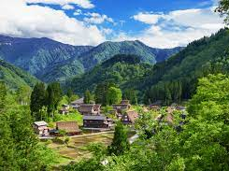
City 市 or Countryside 田舎?

Slide 2
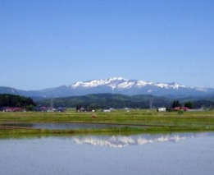
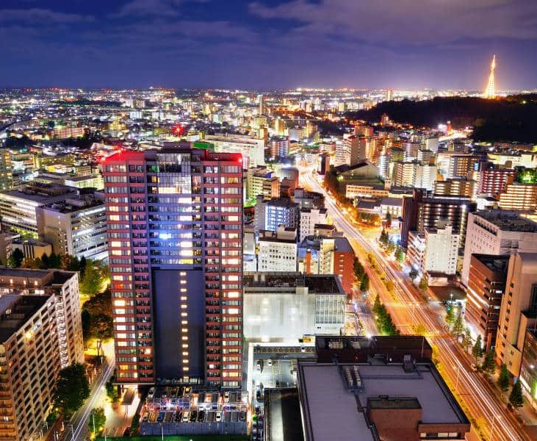
You choose: City市 or Countryside田舎?

Slide 3
1. The (_____) is more interesting より興味深い than the (_____.)
Word Bank:
city 市
countryside田舎
2. I want to live in (______.)
3. Picture!

Slide 4
1. The (countryside) is more interesting より興味深い than the (city.)
city市
countryside
田舎
2. I want to live in (Kurihara.)
3.

