Slide 1
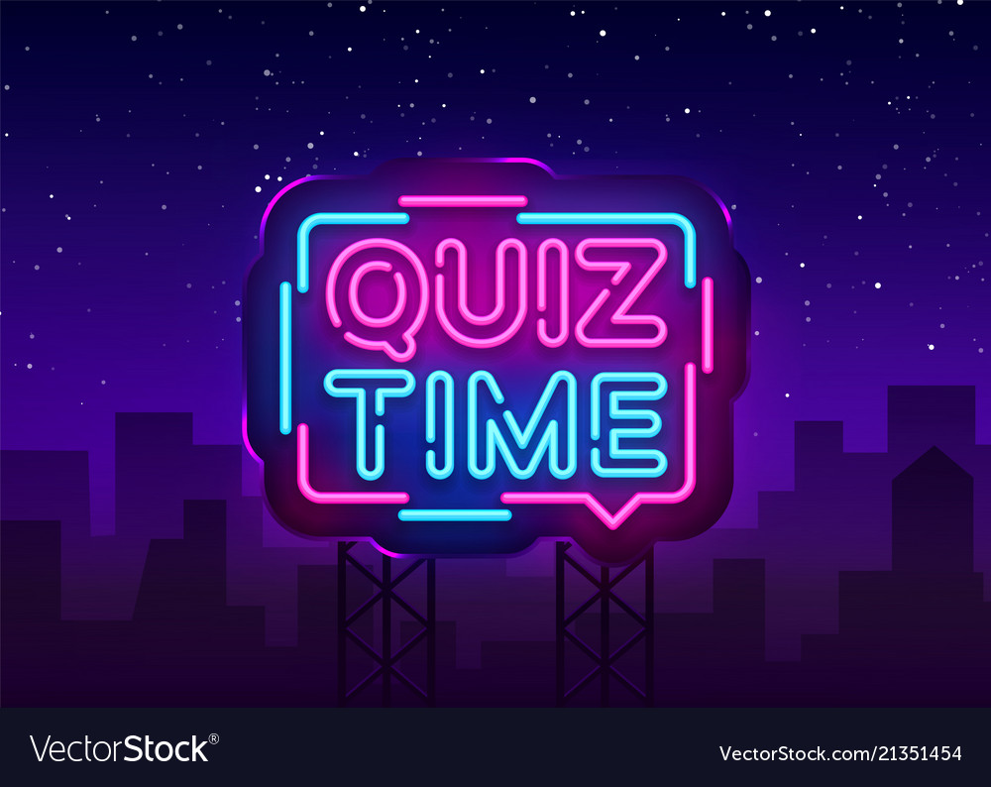

Slide 2
EXAMPLE

Slide 3
eat(s)
A
ate
B
eaten
C
Bananas are ___ by monkeys.

Slide 4
CHALLENGE ONE

Slide 5
take(s)
A
took
B
taken
C
We ___ many pictures last summer.

Slide 6
CHALLENGE TWO

Slide 7
see(s)
A
saw
B
seen
C
A ghost was ___ in the library.

Slide 8
CHALLENGE THREE

Slide 9
make(s)
A
made
B
made
C
His father ___ cakes everyday.

Slide 10
CHALLENGE FOUR

Slide 11
wear(s)
A
wore
B
worn
C
He didn’t ___ a uniform yesterday.

Slide 12
CHALLENGE FIVE

Slide 13
is
A
are
B
was
C
English ___ studied by my mother 10 years ago.

Slide 14
CHALLENGE SIX

Slide 15
are
A
were
B
was
C
Sports ___ played in the gym everyday.

Slide 16
CHALLENGE SEVEN

Slide 17
go
A
went
B
gone
C
Games were played when I ___ to my friend’s house.

Slide 18
LAST CHALLENGE

Slide 19
know
A
knew
B
known
C
I _____ him last year.

Slide 20
THE END

