Slide 1
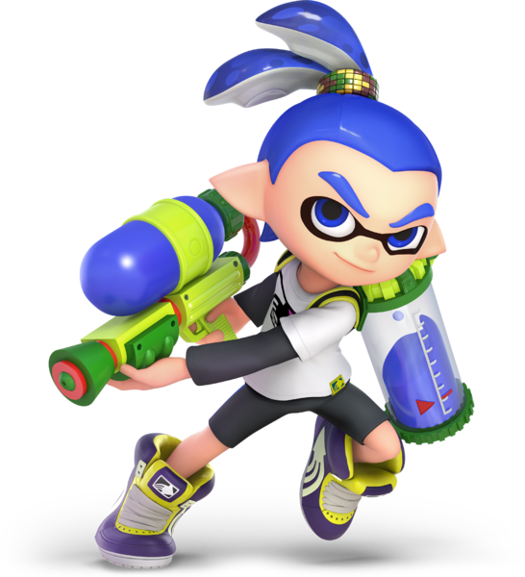
Turf Takeover
Template
* The infinitive and squid cards are supposed to go with this game.

Slide 2
How to play:
Each team picks a prefecture that they want to go to.
You have 15 seconds to write one famous thing that you can do in that prefecture.
If more than 1 team wants to go to the same prefecture, then they must Janken. Whoever wins get the prefecture.
If your team wants challenge another team for their prefecture, then you must Janken. If the challenger wins they get the prefecture. If the challenger loses the other team gets one of the challengers prefectures.
The team with the most prefectures wins.

Slide 3
How to play:
各チームが行きたい都道府県を選びます。
15秒以内にその都道府県でできる有名なことを1つ書いてください。
同じ都道府県に行きたいチームが複数いる場合は、ジャンケンをしてください。勝った方がその都道府県を手に入れることができます。
自分のチームが他のチームの都道府県に挑戦したい場合は、自分も挑戦しなければなりません。挑戦者が勝てば、その都道府県を獲得できます。挑戦者が負けた場合は、他のチームが挑戦者の都道府県を1つ獲得します。
最も多くの県を獲得したチームが勝ちとなります。

Slide 4
例えば：
Here; you would put an example of how the students are supposed to use the grammar. This was originally meant for the 二年生 middle schoolers learning ‘infinitives’. An example is left below.
We want to go to Hokkaido to make snowmen.

Slide 5
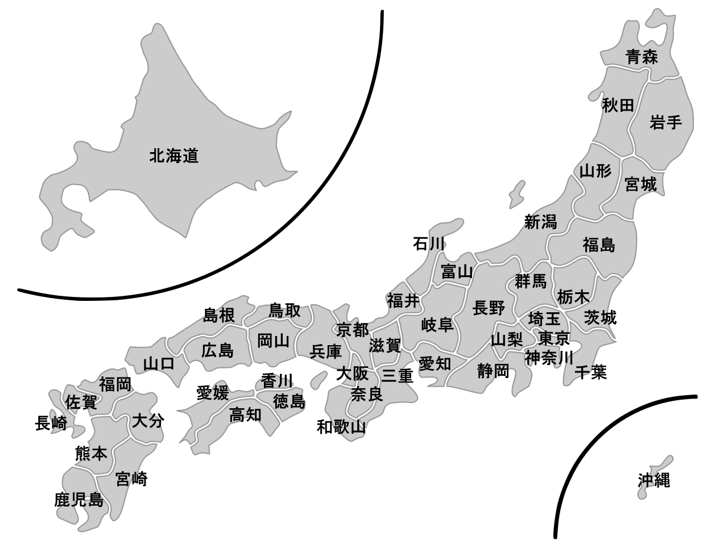
This is the slide where you or the JTE keep track of the students’ territory.
In presentation mode you will have the option to highlight on the slide.
You are able to adjust the colors accordingly for the groups.
Please be aware that yellow and orange look very similar.
You can clear off the board by discarding the changes.

